Slide 1
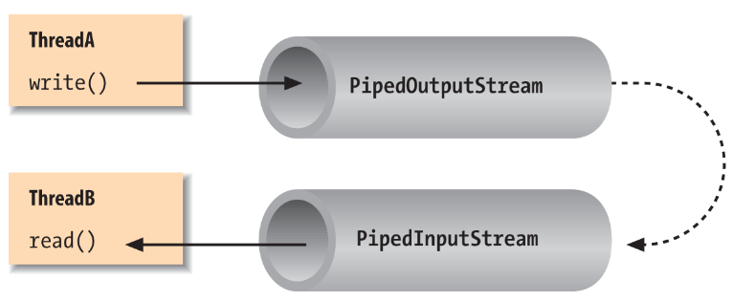
Java IO: Pipes
Creating a pipe using Java IO is done via the PipedOutputStream and PipedInputStream classes. A PipedInputStream should be connected to a PipedOutputStream. The data written to the PipedOutputStream by one thread can be read from the connected PipedInputStream by another thread.
Pipes in Java IO provides the ability for two threads running in the same JVM to communicate. You cannot use a pipe to communicate with a thread in a different JVM (different process).
The pipe concept in Java is different from the pipe concept in Unix / Linux, where two processes running in different address spaces can communicate via a pipe. In Java, the communicating parties must be running in the same process, and should be different threads.
We can connect the two pipe streams using their connect() methods. Both PipedInputStream and PipedOutputStream has a connect() method that can connect one to the other.
Remember, when using the two connected pipe streams, pass one stream to one thread, and the other stream to another thread. The read() and write() calls on the streams are blocking, meaning if you try to use the same thread to both read and write, this may result in the thread deadlocking itself.

